Slide 1
Pareto Points
Karl Lieberherr
Slides from Peter Marwedel
University of Dortmund

Slide 2
How to evaluate designs according to multiple criteria?
In practice, many different criteria are relevant
for evaluating designs:
  (average) speed
  worst case speed
  power consumption
  cost
  size
  weight
  radiation hardness
  environmental friendliness ….
How to compare different designs?
(Some designs are “better” than others)

Slide 3
Definitions
  Let Y: m-dimensional solution space for the
  design problem. Example: dimensions correspond to # of processors, size of memories, type and width of busses etc.
  Let F: d-dimensional objective space for the design problem.
  Example: dimensions correspond to speed, cost, power consumption, size, weight, reliability, …
  Let f(y)=(f₁(y),…,f_{d}(y)) where y∈Y be an objective function.
  We assume that we are using f(y) for evaluating designs.
solution space
objective space
f(y)
y

Slide 4
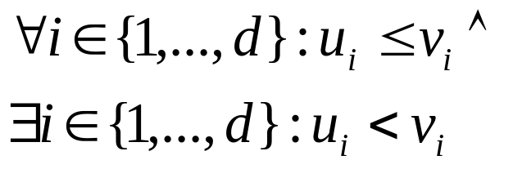
Pareto points
  We assume that, for each objective, a total
  order < and the corresponding order ≤ are defined.
  Definition:
  Vector u=(u₁,…,u_{d})∈ F dominates vector v=(v₁,…,v_{d})∈ F
  ⇔
  u is “better” than v with respect to one objective and not worse than v with respect to all other objectives:
  Definition:
  Vector u∈ F is indifferent with respect to vector v∈ F
  ⇔ neither u dominates v nor v dominates u

Slide 5
Pareto points
  A solution y∈Y is called Pareto-optimal with
  respect to Y ⇔ there is no solution y2∈Y such that
  u=f(y2) is dominated by v=f(y)
  Definition: Let S ⊆ Y be a subset of solutions.
  v is called a non-dominated solution with respect to S
  ⇔ v is not dominated by any element ∈ S.
  v is called Pareto-optimal
  ⇔ v is non-dominated with respect to all solutions Y.

Slide 6
Pareto Points: 25 rung ladder
Objective 1 (e.g. depth)
Pareto-point
worse
24
Using suboptimum decision trees
indifferent
7
Pareto-point
5
better
Pareto-point
indifferent
1
2
3
4
5
Objective 2
(e.g. jars)
(Assuming minimization of objectives)

Slide 7
Pareto Set
Objective 1 (e.g. depth)
Pareto set = set of all Pareto-optimal solutions
dominated
Pareto-
set
Objective 2
(e.g. jars)
(Assuming minimization of objectives)

Slide 8
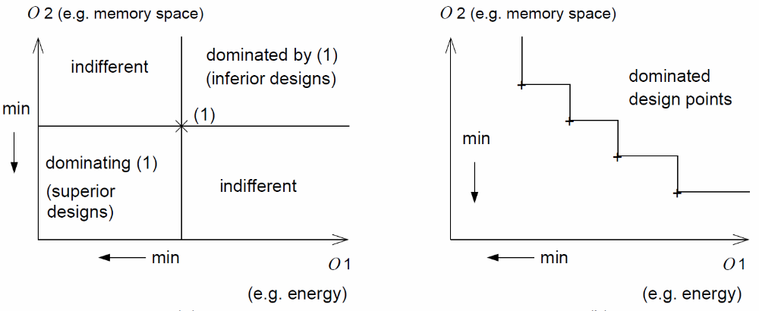
One more time …
Pareto point Pareto front

Slide 9
Design space evaluation
Design space evaluation (DSE) based on Pareto-points is the process of finding and returning a set of Pareto-optimal designs to the user, enabling the user to select the most appropriate design.

Slide 10
Problem
In presence of two antagonistic criteria best solutions are Pareto optimal points
One solution is :
  Searching for Pareto optimal points
  Selecting trade-off point = the Pareto optimal point that is the most appropriated to a design context
criterion1
best
best
criterion 2
pareto optimal point

